Slide 1
Managing Technology
Managing Engineering Design

Slide 2
Chapter Objectives
Nature and phases of engineering design
Stages in the systems engineering
New product development processes
Emphasis on concurrent engineering
Special control system in engineering design
Drawing/design release
Configuration management and design review
Recognize product liability and safety issues
Recognize the significance of reliability and other design factors

Slide 3
Advanced Organizer

Slide 4
Nature of Engineering Design
Design is the central purpose of engineering.
It begins with the recognition of a need and the conception of an idea to meet that need.
It proceeds with the definition of the problem, continues with a program of directed research and development, and leads to the construction and evaluation of a prototype.

Slide 5
Essentially, design is the process of creating a model, usually described in terms of drawings and specifications of a system that will meet an identified need of the customer.
Engineering design process
- logical sequence of activities, decisions and analyses to develop a solution
Customer, internal or external
-
Information
drawings, specification etc.

Slide 6
Systems Engineering/New Product Development
The design of a complex engineered system, from the realization of a need through production to engineering support in use is known as systems engineering (especially with military or space systems) or as new product development (with commercial systems).

Slide 7
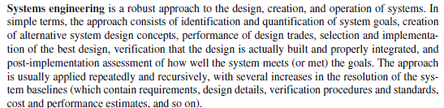
NASA Systems Engineering Handbook

Slide 8
Systems engineering as defined by the International Council on Systems Engineering (INCOSE) is an engineering discipline whose responsibility is creating and executing an interdisciplinary process to ensure that the customer and stakeholder’s needs are satisfied in a high quality, trustworthy, cost efficient, and schedule compliant manner throughout a system’s entire life cycle.

Slide 9
Systems Engineering Process tasks
State the problem
Investigate alternatives
Model the system
Integrate
Launch the system
Assess performance
Reevaluate
Not sequential in nature.
These functions may be performed in a parallel and iterative manner.

Slide 10
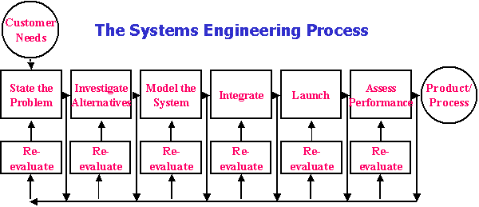

Slide 11
Phases/Stages in Systems Engineering or New Product Development
The phases of the system life cycle extends from original concept through systems engineering to product disposal.
The National Society of Professional Engineers (NPSE) defined stages of new product development as follows:
Conceptual Technical feasibility Development Commercial Validation & Production Preparation | Full-scale production Product Support Disposal Stage

Slide 12
Concurrent Engineering (CE) and CALS
Concurrent Engineering
Technical and nontechnical disciplines unites to define the product to be manufactured.
Philosophy applied to create products that are better, less expensive and more quickly brought to market.

Slide 13
Concurrent engineering, also known as simultaneous engineering, is a method of designing and developing products, in which the different stages run simultaneously, rather than consecutively. It decreases product development time and also the time to market, leading to improved productivity and reduced costs.
Involves cross-functional team (e.g. engineering, marketing, finance/accounting) primary focused on satisfying the customer needs.

Slide 14
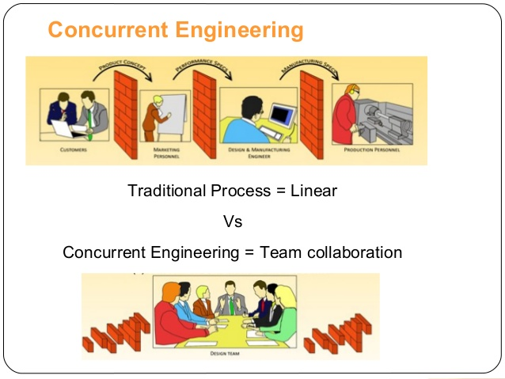

Slide 15
Concurrent Engineering (CE) is a systematic approach to the integrated, concurrent design of products and their related processes, including manufacture and support. This approach is intended to cause the developer, from the outset, to consider all elements of the product lifecycle from concept through disposal, including quality control, cost, scheduling, user requirements.
Society of Concurrent Engineering
Benefits:
30% to 70% development time saving
65% to 90 % fewer engineering changes
20% to 110% higher white collar productivity

Slide 16
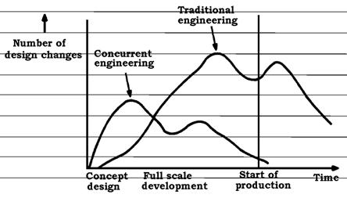

Slide 17
Concurrent Engineering (CE) in Practice
Put together key functional disciplines
Use cross-functional teams
Use of computer-aided design software
Conduct thorough design reviews at design concept and definition stages
Invoke key disciplines, especially manufacturing, early in development
Prepare properly for CE implementation
Allow for a CE learning curve
Implement CE in small, manageable bites

Slide 18
Multispecialty Project Team for Concurrent Engineering
Stage 1
Conceptual
Project Team
* Inventor
Research Engineer
Stage 2
Technical
Feasibility
Project Team
* Research engineer
Developm’t engineer
Marketing / business
Manufac’ng
Engineer
Stage 3
Development
Project Team
*Development engineer
Manufacturing
Engineer
Test engineer
Mktg/Cost Estimator
Stage 4
Commercial Validation & Production Preparation
Project Team
*Design
Engineer
Test engineer
Manufacturing Engineer
Development Engineer
Buyer
Q&A Engineer
Marketing
Stage 5
Full Scale Production
Project Team
*Manufacturing
Engineer
Q&A engineer Test engineer
Construction Engineer
Process Engineer
Mkt/Sales Product cost analyst Field service Buyer Suppliers
Stage 6
Product Support
Project Team
*Marketing and sales
Q&A Training Distributors
Product improvement
Survey
Field service Suppliers

Slide 19
Conceptual Stage begins with defining the design problem.
What is the desired product intended to accomplish?
What functions must it perform?
What performance characteristics must it meet?
What constraints, including legal, limit the solution?
What criteria will be used to judge the quality of the design solution?

Slide 20
Identify four categories of objectives and goals for the solution:
Musts: requirements that must be met.
Must not: constraints defining what the system must not be or do.
Wants: features that would significantly enhance the value of the solution, but are not mandatory – “nice to have”
Don’t wants: characteristics that reduce the value of the solution.
These criteria lead to a set of functional (or operational) requirements defining the required design solution must or should be able to achieve.
Before moving to next phase they must be tested – test of principles.

Slide 21
Technical Feasibility Stage
The objectives of this stage:
To confirm the target performance of the new product through experimentation and/or accepted engineering analysis and
To ascertain that there are no technical or economic barriers to implementation

Slide 22
Development Stage
The objectives of this stage is
To make the needed improvements in materials, designs and processes and
To confirm that the product will perform as specified by constructing and testing engineering prototypes or pilot processes.

Slide 23
Effective development normally requires that design and testing process in parallel in an iterative manner.
Identifying and testing critical materials
Developing and testing components and process steps
Integrating components into subsystems
Uses build-test-fix-retest sequences
Use of mock-up physical models
Technical feasibility carried in much greater detail
Cost estimates in more detail of production, marketing and product support

Slide 24
Commercial Validation and Product Preparation Stage
The objective is “to develop the manufacturing technique and establish test market validity of the new product.”
Selecting manufacturing procedures, production tools and technology, installation and start-up plans for the manufacturing process, and
Selecting vendors for purchased materials, components, and subsystems.
Market validity - preproduction prototypes; market trails - early adopters
Estimate costs and forecast revenue.

Slide 25
Full-Scale Production Stage
Final design, drawings, specifications, flow charts and procedures for manufacturing assembly of all components and sub-systems of product and production facility.
Establish quality control procedures and reliability standards.
Contracts made with supplier and procedures established for product distribution and support.
Manufacturing facilities constructed and trials runs made to “shake down” the new plant and adjustment the process until a quality product is being economically produced.
Evolve product with various changes – continuous improvement

Slide 26
Product Support Stage
The objective is to ensure that the product can be used and maintained by consumers
Prepare technical manuals /user guides for product installation
Operation and maintenance manual
Initiation of customer service program including spare parts and components replacement
Development of warranty plans
Manufacturing and distribution of repair parts and replacements.

Slide 27
Disposal Stage
Every product causes waste during manufacture, while in use, and at the end of useful life that can create disposal problems.
Two pertinent questions to answer in the early stages of product or process design:
“How do we get rid of this?”
“How do we protect the environment?”

Slide 28
CALS essential to the success of concurrent engineering and to modern design techniques.
"Computer Aided Logistics Support," then
"Computer-aided Acquisition and Logistics Support,"
"Continuous Acquisition and Life-Cycle Support," (1993, DoD)
"Commerce At Light Speed" (U.S. Industry)

Slide 29
The CALS initiative is an industry and government strategy to enable more effective generation, management, and use of digital data supporting the life cycle of a product through the use of international standards, business process change, and advanced technology application.
CALS involves electronic storage, transmission, and retrieval of digital data between the following:
engineers representing the several design stages,
organization functions such as marketing, design, manufacturing, and product support, and
cooperating organizations such as customer and supplier.

Slide 30
The ultimate goal of CALS is to structure integrated databases so that people working in different parts of the world and for different organizations can form a virtual organization, working together without mistrust, confusion, or delay on a common problem or product.

Slide 31
Control Systems in Design
Control systems for drawing/design release and configuration management are essential to assure that everyone knows what the official design (configuration) is at any instant, while change can be managed effectively.
Drawing/Design Release
Configuration Management
Design Review

Slide 32
Drawing /Design Release is the process of identifying when a particular design drawing or change has been officially accepted.
With modern team management concepts, the needed specialists are brought together in integrated product teams empowered to create, review, and approve designs concurrently.
Key enablers - Globalization, decentralization, virtual organization, information technology/system.
Today flexibility and responsiveness of the decentralized organization are important key elements for any successful organization.

Slide 33
Configuration Management
It is very important part of the management process to ensure that the communication lines are kept open between designers and the workers in the field, and that changes are relayed and the correction is followed through and completed.
Baselines are part of the material submitted at the end of a phase for approval in the design review, and they form the basis for beginning work in the next phase.
Changes to these baselines during a phase of the design process are governed by a system known as configuration management (or control), which usually involves a committee known as configuration control board (CCB).
The CCB members – major design branches and other functions that are affected by change.

Slide 34
Addressing the problem of the present system of configuration management:
Automated version control
Configuration management
Benefits
Improved communication among partners
Protects shared web source files under rapid development
Enhances development work flow
Saves time
Reduces the number of defect introduced / the costs and time to find defects / maintenance costs
Improves productivity of the development team

Slide 35
Design Review
Conceptual design review may be scheduled during the early part of a program (preferably four to eight weeks after program start) when operational requirements and the maintenance concept have been defined.
System design review are generally scheduled during the preliminary design phase when preliminary system layouts and specifications have been prepared (before their formal release).
System/software design review are scheduled during the detail design and development phase when layouts, preliminary mechanical and electrical drawings, functional and logical diagrams, design databases, and component part list are available.
Critical design review is scheduled after detail design has been completed, but prior to the release of firm design data to production.

Slide 36
Special Considerations in Design
Product liability
Safety
Reliability
Maintainability
Availability
Ergonomics
Producibility

Slide 37
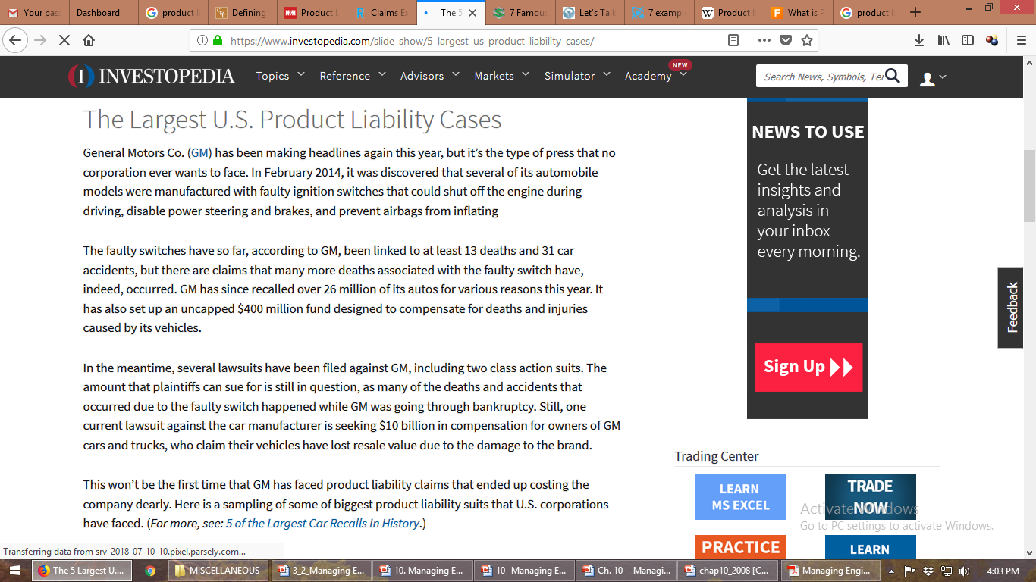

Slide 38
Product liability refers to a manufacturer or seller being held liable for placing a defective product into the hands of a consumer.
Responsibility for a product defect that causes injury lies with all sellers of the product who are in the distribution chain.
In general terms, the law requires that a product meet the ordinary expectations of the consumer.
When a product has an unexpected defect or danger, the product cannot be said to meet the ordinary expectations of the consumer.

Slide 39
To protect against product liability, designer must foresee unlikely conditions
Product contains adequate warnings
Risks reduced to greatest extent possible
Meets user’s reasonable expectations of safety

Slide 40
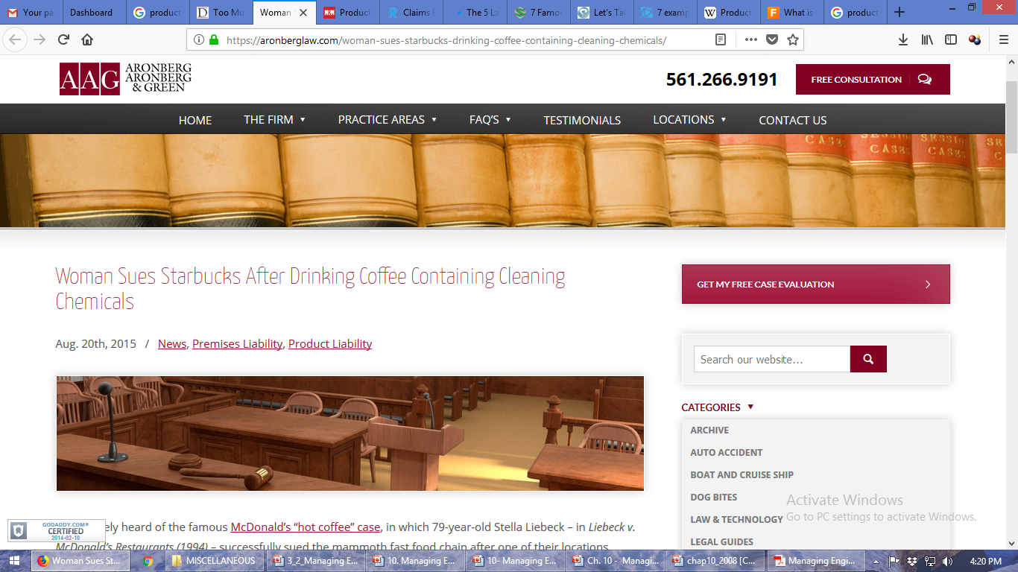
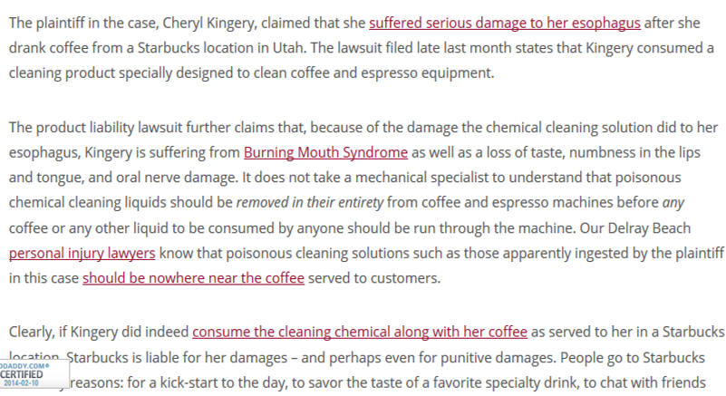

Slide 41
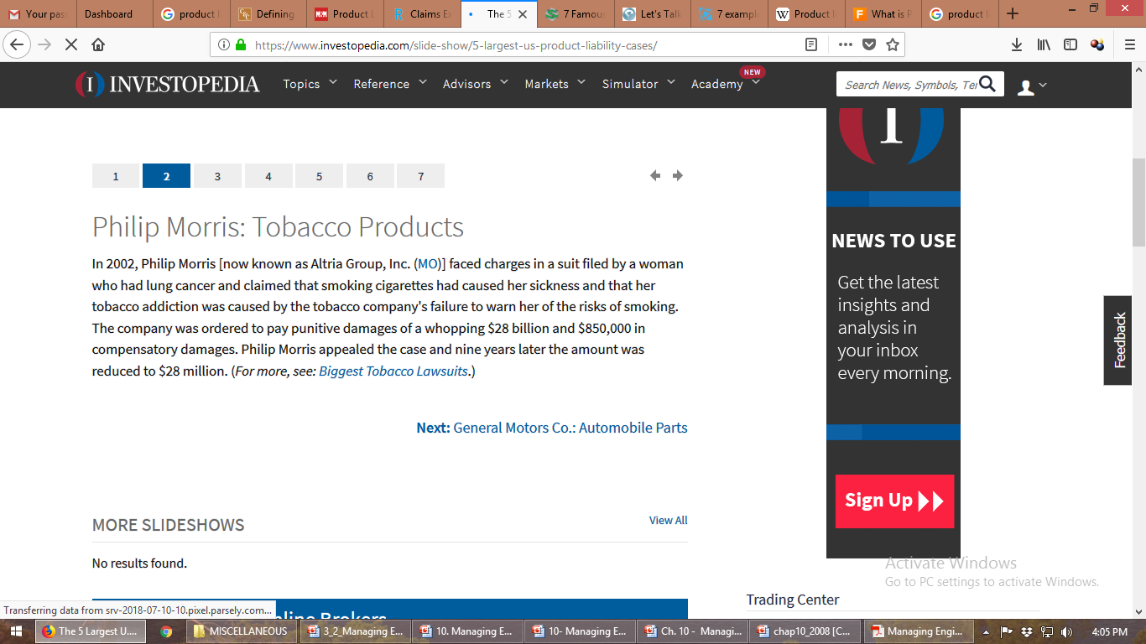
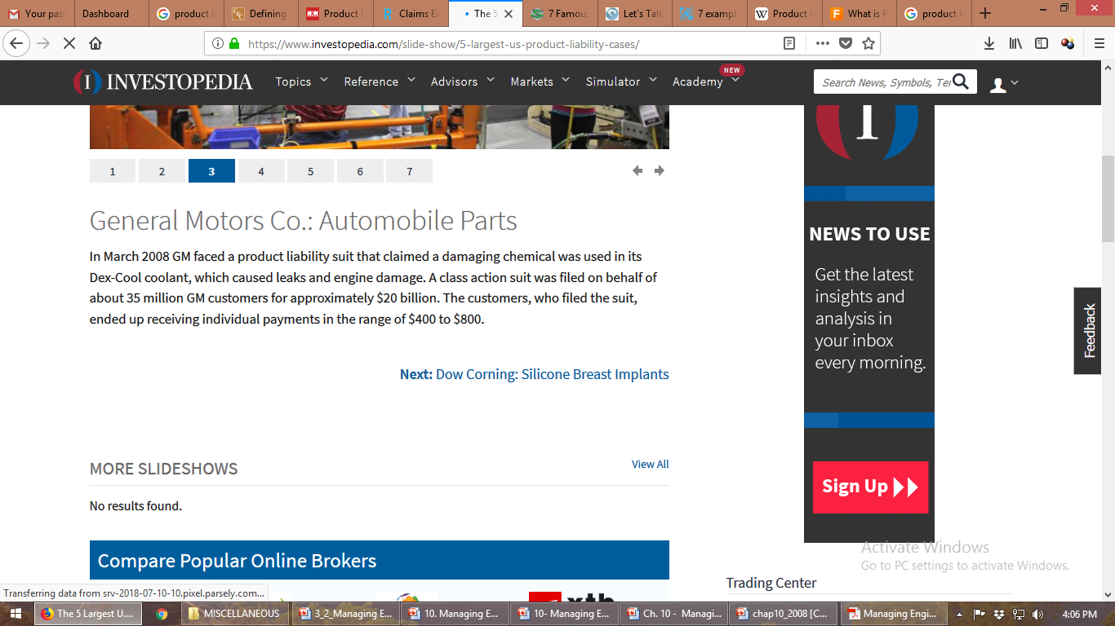
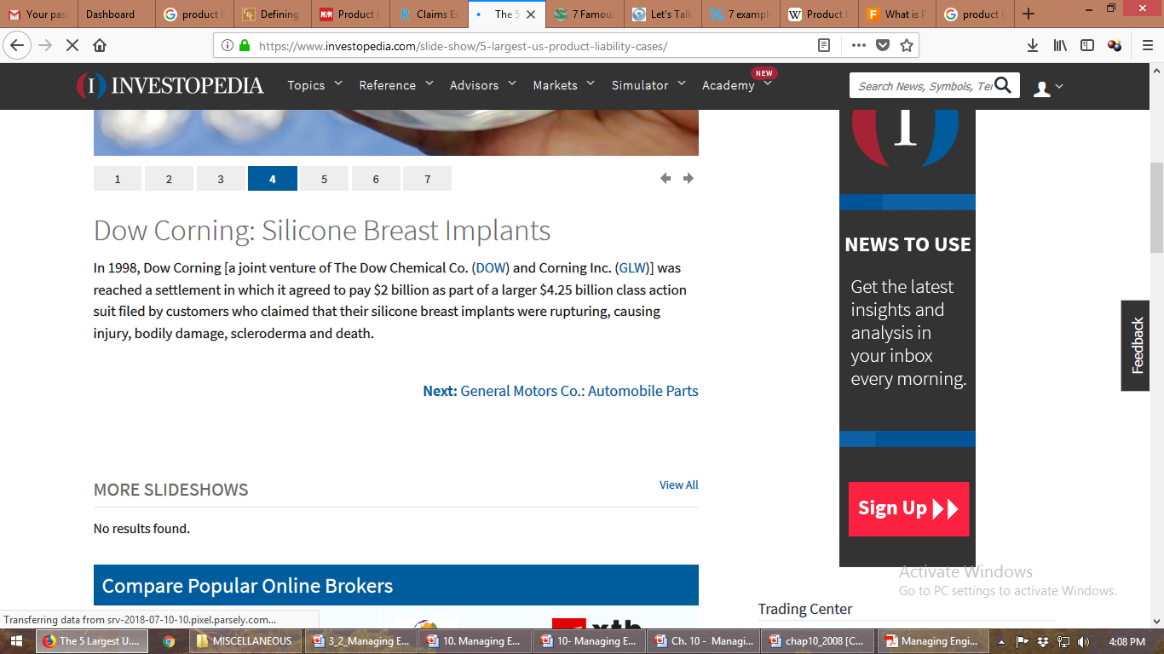

Slide 42
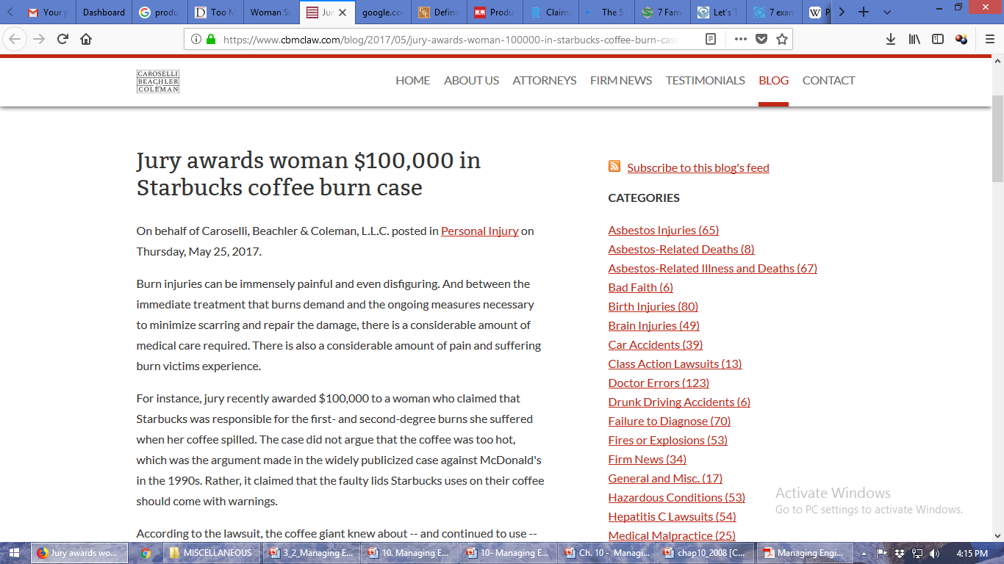

Slide 43
Toyota Prius
In late 2018, Toyota recalled nearly 2.5 million Prius vehicles after finding a software glitch that could cause the cars to stall at high speeds. Four years earlier, the company recalled 1 million cars because of a similar bug.
Toyota’s alleged failure to properly patch the software generated several lawsuits.
In 2019, a jury ordered the company to pay $15.8 million in damages to a California car dealer who claimed Prius safety concerns caused his business to lose profits.

Slide 44
Boeing 737 MAX
The Federal Aviation Administration points to software defects as the root of two fatal Boeing 737 MAX airplane crashes due to automatic control system malfunctions.
According to Reuters, hundreds of lawsuits have been filed against Boeing by families of the victims of the October 2018 Lion Air crash in Indonesia and the March 2019 Ethiopian Air disaster.
The company settled the first lawsuits in the fall of 2019 and is expected to be held liable for more wrongful death claims.
Fortune reports that Boeing shareholders are currently suing the company’s directors for negligence when rushing the aircraft to market. Boeing has since grounded all 737 MAX aircrafts, which led to a January 2020 settlement with American Airlines.

Slide 45
Tesla Model S and Model X
In May 2020, a class action lawsuit was filed against Tesla over a failing touch screen that operates safety-related systems, including critical gauges and warning notifications whose failure could put drivers at risk of harm.
The company refunded some owners repair costs and expanded its warranty to cover the memory device failure that led to the touchscreen issues. In January 2021, the company recalled 135,000 vehicles in response to a National Highway Traffic Safety Administration (NHTSA) request.

Slide 46
Case 1: A Tax Program You manufacture and sell, through distributors, a general purpose program to assist small companies in handling their taxes. You provide the program with a limited warranty that offers to refund the users' payments if the product is defective. One user claimed that data provided by your program misled him into making an unsound investment that cost him a substantial amount of money. On investigation, you found that there was a bug in the program that could have produced the fallacious information your user claims. What are the legal consequences? You would obviously try to get the user to accept a refund of the $450 he paid for the program in return for a full release from any further liability. While worth a try, this strategy is not a guaranteed success. Your user, who did not buy the program directly from you, could not claim under a contract. Also, since no physical injury or property damage was involved, claims cannot be made under strict liability. The final recourse, therefore is to claim negligence. Here, the question is: did you follow best industrial software development practices to assure that such problems did not occur? If the court can be convinced that you did, you would likely win. If not, you could pay substantial damages.

Slide 47
Case 2: A Computerized Drafting System You manufacture, sell, and service an advanced computerized system for producing architectural drawings and specifications. The system is program controlled with a range of optional and custom features. You sell it under a warranty that limits your liability to five times the total moneys paid for the system. One of your customers claims that he bought your system expressly to complete a rush project and that program defects severely delayed his work. He missed his committed dates, forfeited a substantial incentive payment, and lost money on the architecture contract. He claims defects in your software caused several files to be garbled, necessitating extensive rework. On investigation, you find that a software defect could have caused the alleged problem. What are the legal consequences? Since there have been no personal injuries or property damage, strict liability is not involved and the issues concern negligence and warranty. While you are not anxious to pay the warranty maximum of five times the $9,500 paid for the system, you want to avoid having to pay the total claimed damages of $450,000. Your strategy is thus:

Slide 48
1. You first claim that he was responsible for the failure to deliver on schedule, not your system. 2. You will next claim that the warranty limits your liability to $47,500. Your customer will first assert that you negligently designed, developed, and supplied the system software and that the contractual limitations are not valid. Your defense is to show that you exercised reasonable care in developing and testing the software. If his negligence claim fails, your customer will next claim that you, the expert, misled him, the neophyte, about the system's capabilities. Thus, the contract is not valid and the sales claims were guarantees. Here, you argue that your customer is knowledgeable and that you made no invalid claims about the system's capabilities. Finally, the customer could claim under the contract that your system did not perform as promised. If your product actually had the defect claimed, you could well pay the contractually limited damages.

Slide 49
Case 3: An Automated Tunneling Machine You manufacture and market a sophisticated computerized drilling machine that senses underground conditions while drilling tunnels. It is designed to determine the structural strength of the strata through which it drills and to keep the miners informed about mine conditions. Your machine is marketed under a warranty that limits your liability to ten times the moneys paid for the machine. One of your machines was used in a coal mine to dig a tunnel where there was a fire, a collapse, and a loss of life. While no one survived to tell what happened, the miners' families claim that your machine was defective because it did not alert them to the presence of methane or the likelihood of a collapse. Here, the argument concerns strict liability. If your machine contributed to the damages, you will almost certainly be held liable. If it did not, you will probably have no liability. The issue could thus revolve around the likely behavior of your machine and whether it could have caused the alleged accident either through its design or through a malfunction. Experts would likely be used to examine your product to see if there were any plausible ways that it could have contributed to the accident. Here, sound design methods, state-of-the-art quality practices, and comprehensive testing are your best defenses. In every one of these example cases, poor software quality practices can be a serious disadvantage. This is particularly true if the practices of your software people do not at least equal the best in your industry. If they do not, your exposures could easily exceed your contractually limited liability

Slide 50
Reducing Liability
Include safety as a primary specification for product design.
Use standard, proven materials and components.
Subject the design to thorough analysis and testing.
Employ a formal design review process in which safety is emphasized.
Specify proven manufacturing methods.
Assure an effective, independent quality control and inspection process.
Be sure that there are warning labels on the product where necessary.

Slide 51
Supply clear and unambiguous instructions for installation and use.
Establish a traceable system of distribution, with warranty cards, against the possibility of product recall.
Institute an effective failure reporting and analysis system, with timely redesign and retrofit as appropriate.
Document all product safety precautions, actions, and decisions through the product life cycle.

Slide 52
Act rapidly to determine the maturity of your software process.
If it is low, as it probably is, take immediate and aggressive improvement action
Launch and maintain a permanent emphasis on software process improvement.
Utilize the best state-of-the-art development and test practices.
Utilize applicable new technology developments.
Maintain a quality distribution and support system.
Under the guidance of experts, institute design-for-safety practices.
Improve your contracts:
Get competent legal advice.
Be sure your customers are aware of all product risks.
Use clear and reasonable warranties.
Meet your commitments.
5. Until you have taken these steps, avoid delivering complex software to high risk markets

Slide 53
Safety. Safeguards to reduce or eliminate accidents influenced by:
Design
Proven materials and components
Proven manufacturing methods
Clear instruction

Slide 54
Reliability is
the probability that a system
will demonstrate specified performance
for a stated period of time
when operated under specified conditions.
If the required function, the duration, or environment in which a system operates changes, so does the probability of success (reliability)

Slide 55
Risk may be defined as the chance (i.e., the probability) of injury, damage, or loss.
Probability and statistics may assist in making good decisions in our daily lives in a technological age.
Example: fear of flying and increased chance of death (one in a million) produced by travelling
1,000 miles by jet
300 miles by car
10 miles by bicycle

Slide 56
Simple Reliability Models
Example
Consider a system whose purpose is to turn on an electric light on demand over a period of a year under household conditions. Our components are two lamps with a reliability over that period of R_{L} = 0.8, and two switches with a reliability R_{s} = 0.9 . We can implement four different model of reliability.

Slide 57
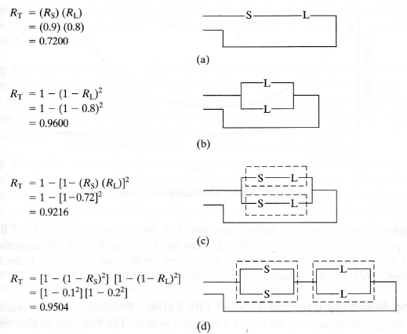
Simple Series Model
Simple Parallel Model
Series in Parallel Model
Parallel in Series

Slide 58
The bathtub curve is widely used in reliability engineering. It describes a particular form of the hazard function which comprises three parts:
The first part is a decreasing failure rate, known as early failures.
The second part is a constant failure rate, known as random failures.
The third part is an increasing failure rate, known as wear-out failures.

Slide 59
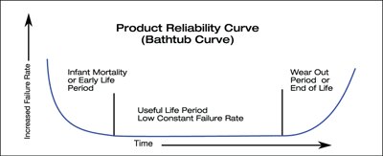
The (approximately) constant failure rate period is the preferred useful life of the system.
During this period, the system can be modeled as having a constant hazard (instantaneous failure) rate lambda (1/λ) in failures per unit time. The inverse of this rate (1/1/λ) is the mean time between failures (MTBF), a common figure of merit for reliability.

Slide 60
Mean time between failures (MTBF) describes the expected time between two failures for a repairable system, while mean time to failure (MTTF) denotes the expected time to failure for a non-repairable system.
For example, three identical systems starting to function properly at time 0 are working until all of them fail. The first system failed at 100 hours, the second failed at 120 hours and the third failed at 130 hours.
The MTBF of the system is the average of the three failure times, which is 116.667 hours. If the systems are non-repairable, then their MTTF would be 116.667 hours.
In general, MTBF is the "up-time" between two failure states of a repairable system during operation

Slide 61
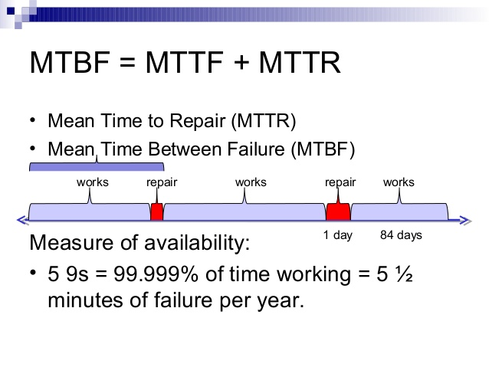

Slide 62
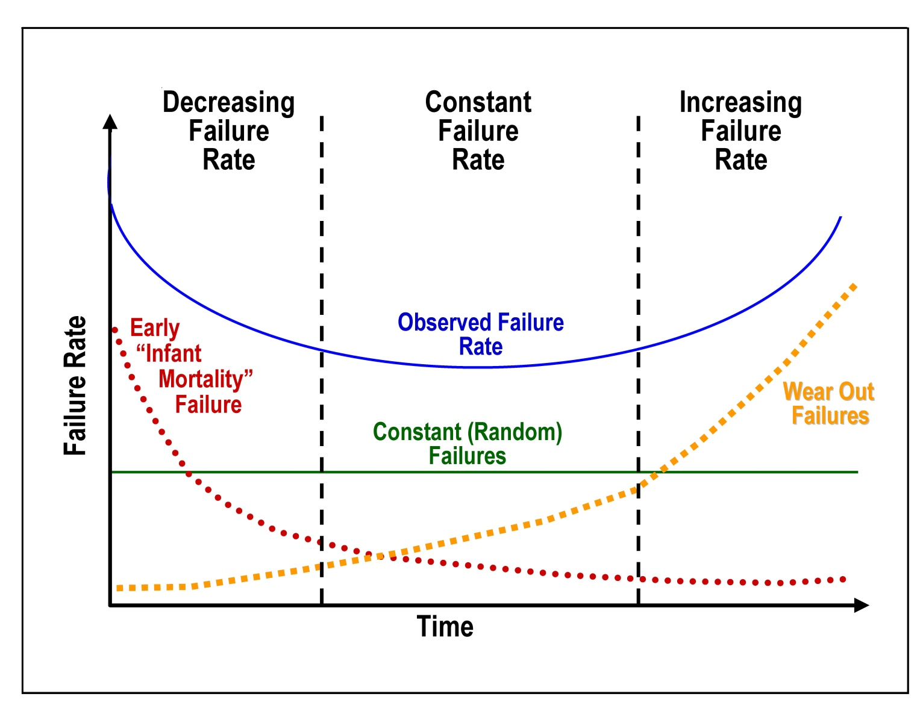

Slide 63
Developing Reliability over the Product Life Cycle
Planning and Apportionment
Reliability is a continuing concern throughout design, manufacture, and use of a complex system.
The first step in planning is establishing a reliability goal (the desired probability of successful operation) and its complement, the acceptable failure rate, for the system.
This system failure rate is then divided into acceptable failure rates for each subsystem and component (reliability apportionment).
The component failure rates, in turn, become the design targets for component designers.

Slide 64
Designing for Reliability
“Start with the best” – to specify and use parts of known high quality – much more expensive, but worth it where the cost of failure is high.
Providing redundancy, using components in parallel.
Example: a jet airliner with two, three, or four independent hydraulic lines or electrical wires to control a critical function – routed through different paths, so a single incident will not affect them all.
Redundancy can often be enhanced by having non-operating standby spares that are not turned on unless the primary unit fails.

Slide 65
Reliability is enhanced by assuring a comfortable factor of safety, which is the ratio of the minimum strength provided by the design to the maximum stress anticipated in use.
Fail-safe design – if the failure does occur it leaves the system in safe (although perhaps inoperable) condition.
Flattening the Bathtub Curve
Useful life may be extended by replacing those parts that wear out quickly (such as the brake linings on a car), but sooner or later there comes a point where it is cheaper to replace a system than to maintain it.

Slide 66
Maintainability is
the probability that a failed system
will demonstrate it can be restored to specified performance
for within a stated period of time
when operated maintained under specified conditions.

Slide 67
Maintenance downtime has three components
Administrative and preparation time
Logistics time
Active maintenance time

Slide 68
Types of Maintenance
Corrective – changes made to repair defects in the design
Adaptive - adds enhancements to an operational system
Perfective - to improve response time, system efficiency, reliability, or maintainability
Preventive - changes made to a system to reduce the chance of future system failure

Slide 69
The average time between maintenance actions is the mean time between maintenance (MTBM).
The average total time for the three components of maintenance is the mean downtime (MDT).
Maintainability may alternatively be defined by just the active maintenance time for corrective maintenance mean time to repair (MTTR), since only the preceding item 3 is substantially influenced by the designer.
The reliability measure of MTBF , the inverse of the hazard rate 1/λ, is often used with the MTTR.

Slide 70
The designer can reduce active maintenance time by providing easy access to the system, dividing the system into modules that can be replaced as units, specifying preventive maintenance that delay deterioration and identifying worn parts, and providing clear, comprehensive maintenance manuals.

Slide 71
Maintainability can be enhanced by creating realistic system models – physical mockups on which maintenance actions can be at least simulated by typical repair people, or using the output of a CAD process, three-dimensional computer simulations that can be rotated and enlarged to provide visibility and understanding potential maintenance difficulties.

Slide 72
Availability, in the simplest form, is:
A = Uptime/(Uptime + Downtime)
For example, a unit that is capable of being used 100 hours per week (168 hours) would have an availability of 100/168.
However, typical availability values are specified in decimal (such as 0.9998). In high availability applications, a metric known as nines, corresponding to the number of nines following the decimal point, is used.
With this convention, "five nines" equals 0.99999 (or 99.999%) availability.

Slide 73
Availability, Inherent (Ai) The probability that an item will operate satisfactorily at a given point in time when used under stated conditions in an ideal support environment.
It excludes logistics time, waiting or administrative downtime, and preventive maintenance downtime. It includes corrective maintenance downtime.
Inherent availability is generally derived from analysis of an engineering design and is calculated as the mean time to failure (MTTF) divided by the mean time to failure plus the mean time to repair (MTTR). It is based on quantities under control of the designer.

Slide 74
Availability, Achieved (Aa) The probability that an item will operate satisfactorily at a given point in time when used under stated conditions in an ideal support environment (i.e., that personnel, tools, spares, etc. are instantaneously available).
It excludes logistics time and waiting or administrative downtime. It includes active preventive and corrective maintenance downtime.

Slide 75
Availability, Operational (Ao) The probability that an item will operate satisfactorily at a given point in time when used in an actual or realistic operating and support environment.
It includes logistics time, ready time, and waiting or administrative downtime, and both preventive and corrective maintenance downtime. This value is equal to the mean time between failure (MTBF) divided by the mean time between failure plus the mean downtime (MDT).
This measure extends the definition of availability to elements controlled by the logisticians and mission planners such as quantity and proximity of spares, tools and manpower to the hardware item.

Slide 76
Example
If we are using equipment which has a mean time to failure (MTTF) of 81.5 years and mean time to repair (MTTR) of 1 hour:
MTTF in hours = 81.5*365*24=713940 (This is a reliability parameter and often has a high level of uncertainty!)
Inherent Availability (Ai) = MTTF/(MTTF+MTTR) = 713940/713941 =99.999859%
Inherent Unavailability = 0.000141%
Outage due to equipment in hours per year = 1/rate = 1/MTTF = 0.01235 hours per year.

Slide 77
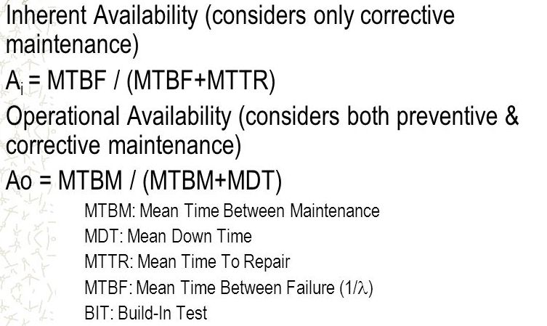

Slide 78
_{Human Factors (Ergonomics)}
Also known as ergonomics, is concerned with ways of designing machines, operations, and work environment to match human capacities and limitations.
Human factors and ergonomics (HF&E), also known as comfort design, functional design, and systems, is the practice of designing products, systems, or processes to take proper account of the interaction between them and the people who use them.

Slide 79
The field has seen contributions from numerous disciplines, such as psychology, engineering, biomechanics, industrial design, physiology, and anthropometry.
In essence, it is the study of designing equipment and devices that fit the human body and its cognitive abilities.

Slide 80
The International Ergonomics Association defines ergonomics or human factors as follows:
Ergonomics (or human factors) is the scientific discipline concerned with the understanding of interactions among humans and other elements of a system, and the profession that applies theory, principles, data and methods to design in order to optimize human well-being and overall system performance.

Slide 81
HF&E is employed to fulfill the goals of occupational health and safety and productivity. It is relevant in the design of such things as safe furniture and easy-to-use interfaces to machines and equipment.
Proper ergonomic design is necessary to prevent repetitive strain injuries and other musculoskeletal disorders, which can develop over time and can lead to long-term disability.

Slide 82
Human factors and ergonomics is concerned with the "fit" between the user, equipment and their environments. It takes account of the user's capabilities and limitations in seeking to ensure that tasks, functions, information and the environment suit each user.

Slide 83
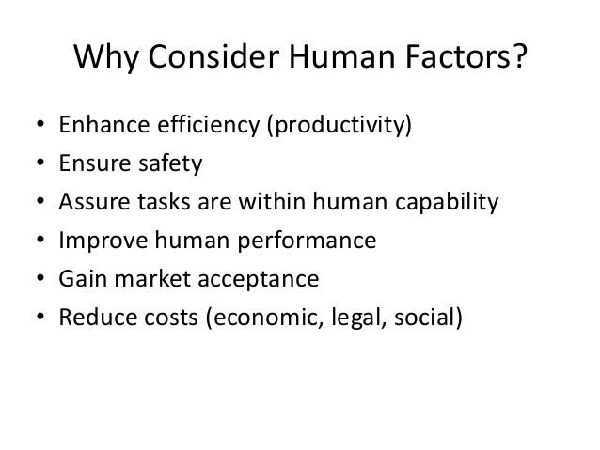

Slide 85
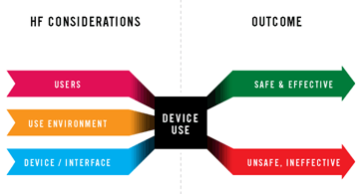

Slide 86
Producibility. As a product is being designed, careful attention should be paid to ensure that it can be produced economically, using available processes and equipments where possible.
(plural producibilities)
the quality or state of being producible
the measure of the relative ease of manufacturing

Slide 87
Manufacturing engineers familiar with production capabilities should be involved in reviewing parts as they are designed, suggesting tolerances, materials, and shapes that are more producible.

Slide 88
Value Engineering
The concept of value engineering evolved in the 1940s at General Electric, in the midst of World War II. Due to the war, purchase engineer Lawrence Miles and others sought substitutes for materials and components, since there was a chronic shortage of them.
These substitutes were often found to reduce costs and provided equal or better performance.

Slide 89
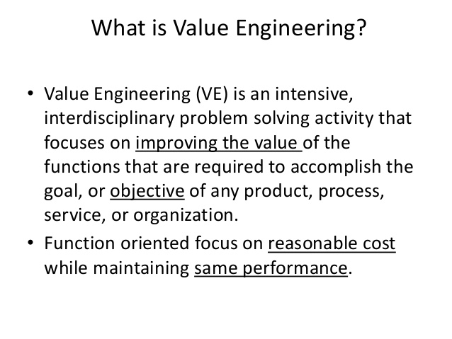

Slide 90
Value Engineering/Analysis
A methodological study of all components of a product in order to discover and eliminate unnecessary costs over the product life cycle without interfering with the effectiveness of the product.
A systematic and organized approach to provide the necessary functions in a project at the lowest cost.

Slide 91
Value engineering promotes the substitution of materials and methods with less expensive alternatives, without sacrificing functionality. It is focused solely on the functions of various components and materials, rather than their physical attributes. Also called value analysis.

Slide 92
Value Engineering
focuses on those value characteristics which are deemed most important from the customer point of view.
is a powerful methodology for solving problems and/or reducing costs while maintaining or improving performance and quality requirements.
can achieve impressive savings, much greater than what is possible through conventional cost reduction exercise even when cost reduction is the objective of the task.

Slide 93
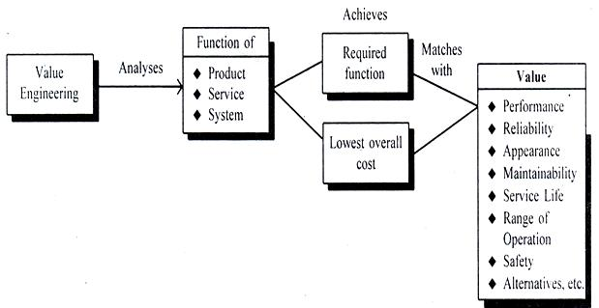

Slide 94
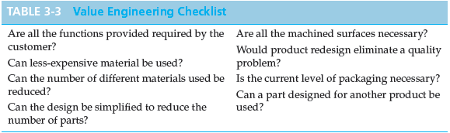

Slide 95
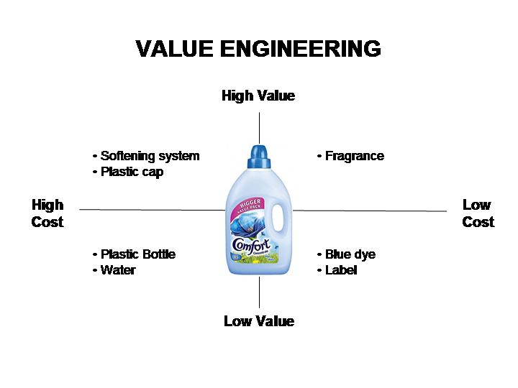

Slide 96
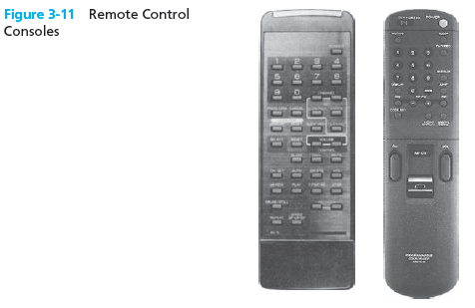

Slide 97
